Slide 1
STEEL DESIGN
Dr. Harpal Singh
Professor
GNDEC, Ludhiana

Slide 2
Text: 1) Steel Structures, Design & Behavior (4thEd.)
Salman & Johnson.
2) Manual of Steel Construction (LRFD) AISC (3rdEd.)
Course Objectives:
Expose students to the concepts and fundamentals
of steel design and provide design skill to undertake
design problems in Steel Construction.

Slide 3

STEEL DESIGN
Four Stages for the Engineering Projects:
Function.
I – Planning Stage.
Size.
Cost (Budget)
Architectural
II – Design Stage.
Structural
III – Construction Stage.
IV – Operation and Maintenance Stage.
1

Slide 4
STRUCTURAL DESIGN
It is a mixture of art and science to produce a
safe and economical structure that serves its intended purpose.
Min. Weight.
Min. Cost.
Min Construction Time.
Min. Labor Force.
Min. Operational Cost.
Design is an
optimization process
2

Slide 5
Iterative Design Cycle:
1: Planning, Function Design.
2: Preliminary Structural Configuration.
3: Establish Load Cases & Load Combinations.
4: Preliminary Member Selection.
5: Structural Analysis.
6: Evaluation of all members to meet strength and
serviceability Criteria.
No
7: Redesign by going to step “3” above.
8: Final Design thus optimum design is achieved.
Yes
3

Slide 6
History of STEEL STRUCTURES
- 1840 Cast Iron.
arch-shaped bridges upto 30^{m} span.
1840 - 1890 Wrought Iron.
Spans upto 100^{m}.
1870 - 1920 Bessemer Converter
Introduction to Carbon Steel.
1920 - Todate Third most popular construction material
after Concrete and Timber.
4

Slide 7
L O A D S
1 – Dead Loads: Also known as gravity loads, includes the
weight of the structure and all fixed and
permanent attachments.
2 – Live Loads: Also belong to gravity loads, but their
intensity and location may vary
(non-permanent loads).
3 – Highways / Rail Live Loads:
AASHTO, AREA
3 – Impact Loads:
Associated with Live Loads.
4 – Snow Loads:
20 to 40 psf (  1000 to 2000 Pa )
5

Slide 8
L O A D S (Cont.)
6 – Wind Loads: Static Wind Pressure = q C_{e}C_{g}C_{p}
where q = Dynamic pressure = 1/2pv²
C_{e} = Exposure Factor ( 1 to 2 )
C_{g} = Gust Factor ( above 2 )
C_{p} = Shape Factor ( about 1.5)
7 - Earthquake Load:
Latitude Load on structure.
8 - Thermal Loads:
For Indeterminate Structures.
9 – Other Loads:
e.g. - Rain Loads - Ponding
- Hydrostatic Loads
- Blast Loads.
6

Slide 9
Type of Structural Steel Sections:
Hot-Rolled Sections.
Cold Formed Sections.
Built-Up Sections.
Steel Structural Sections
7

Slide 10
Type of Structural Steel Sections:
Hot-Rolled Sections.
W
(a) Wide-flange
Shape
S
(b) Indian
Standard
Beam
C
(c) Indian
Standard
Channel
L
(d) Angle
WT or ST
(e) Structural
Tee
(f) Pipe
Section
(g) Structural
Tubing
a – Wide-flange : W 18 × 97
b – Standard (I) : S 12 × 35
c – Channel : C 9 × 20
d – Angles : L 6 × 4 × ½
e – Structural Tee : WT, MT or ST e.g. ST 8 × 76
f & g – Hollow Structural Sections HSS : 9 or 8 × 8
(h) Bars
(i) Plates
Standard rolled shapes.
8

Slide 11
Type of Structural Steel Sections:
Cold Formed Sections
(a) Channels
(b) Zees
(c) I-shaped double channels
(d) Angles
(e) Hat sections
9

Slide 12
Type of Structural Steel Sections:
Built-Up Sections.
Built-up (W) shapes.
Built-up (C) Channels.
Built-up (L) Angles.
10

Slide 13
Type of Structural Steel Sections:
Tension Members.
(a) Round and rectangular
bars, including eye bars
and upset bars.
(b) Cables composed
of many small wires.
(c) Single and double
angles.
Perforated
plates
(d) Rolled W – and S –
sections.
(e) Structural
tee.
(f) Build-up box
sections.
11

Slide 14
Type of Structural Steel Sections:
Compression Members.
(a) Rolled W-and S-
sections.
(b) Double
angles.
(c) Structural
tee.
(d) Structural
tubing
(e) Pipe
section
(f) Built-up section
12

Slide 15
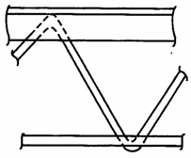
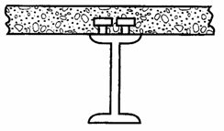
Type of Structural Steel Sections:
Bending Members.
(a) Rolled W-and
other I-shaped
sections.
(b) Build-up
Sections.
(c) open web joist.
(d) Angle
(e) Channel
(f) Built-up members
(g) Composite steel-Concrete
13

Slide 16
Philosophies of Design:
A)
Working Stress Design (Allowable Stress Design),
widely known as (ASD) – used for over 100 years.
Limited States Design (Load & Resistance Factor Design),
also known as (LRFD) – first introduced in 1986.
A limit state means “A set of conditions at which a
structure ceases to fulfill its intended function”.
Two types of limit states exist, these are:
- Safety (Strength).
- Serviceability (Deformation).
B)
-
-
14

Slide 17
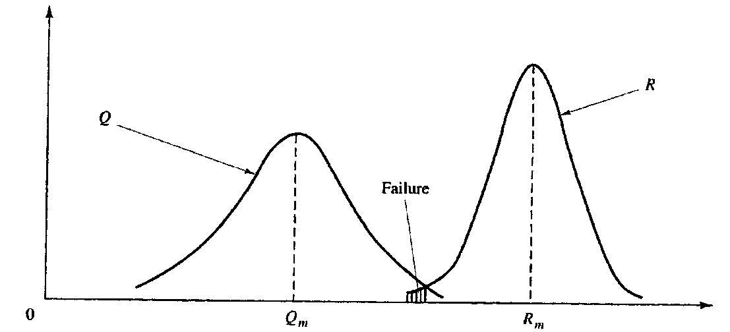
Assume load effects on structures = Q
Assume Resistance to these loads = R
Establishing frequency distribution for (Q) & (R):
Frequency
Resistance R, Load Q
Frequency distribution of load Q and resistance R.
Thus always R_{m} > Q_{m}, and the ratio of R/Q defines the “Factor of Safety”,
such:
R
Q
= Factor of Safety (F.S.).
15

Slide 18
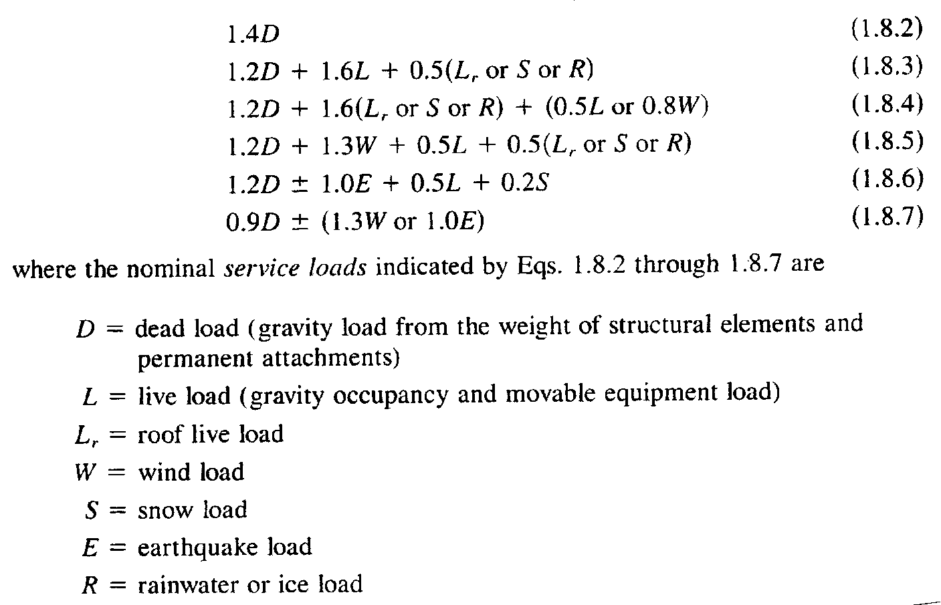
AISC - Load & Resistance Factor Design
Let () = Strength Reduction Factor (Due to material and / or construction)
Let () = Overload Factors ( Due to unexpected conditions).
R ≥ ‪_{i}Q_{i} (i = type of loading)
This approach was presented in the ASCE-7, and was adopted by the AISC-LRFD of 1986.
16

Slide 19
Factor of Safety:
Allowable Stress Design (ASD):
suppose R is the reduction in resistance.
suppose Q is the increase in loading.
Load & Resistance Factor Design (LRFD)
1.4 D = 0.90 R (First load case)
1.56 D = R LRFD
 F.S. = R/D = 1.56 LRFD, compared to:
F.S. = R/Q = 1.67 ASD
17

Slide 20
Structural Steels:
ASTM (A33) Steel with Fy = 33 ksi up to 1960.
Today steel offer wide choice of yield from 25 ksi upto 100 ksi,
among other different characteristics. The majority of construction
steels are grouped under the following main groups:
A) Carbon Steels:
low carbon [C < (0.15%)]
mild carbon [0.15% < C< 0.3%] such as A-36, A-53.
medium carbon [0.3% C < 0.6%] A-500, A-529.
high carbon [0.6% < C < 1.7%] A-570
B) High-Strength Low-Alloy Steels:
Having Fy 40 ksi to 70 ksi, may include chromium,
copper, manganese, nickel in addition to carbon.
e.g. A-242, A-441 and A-572.
18

Slide 21
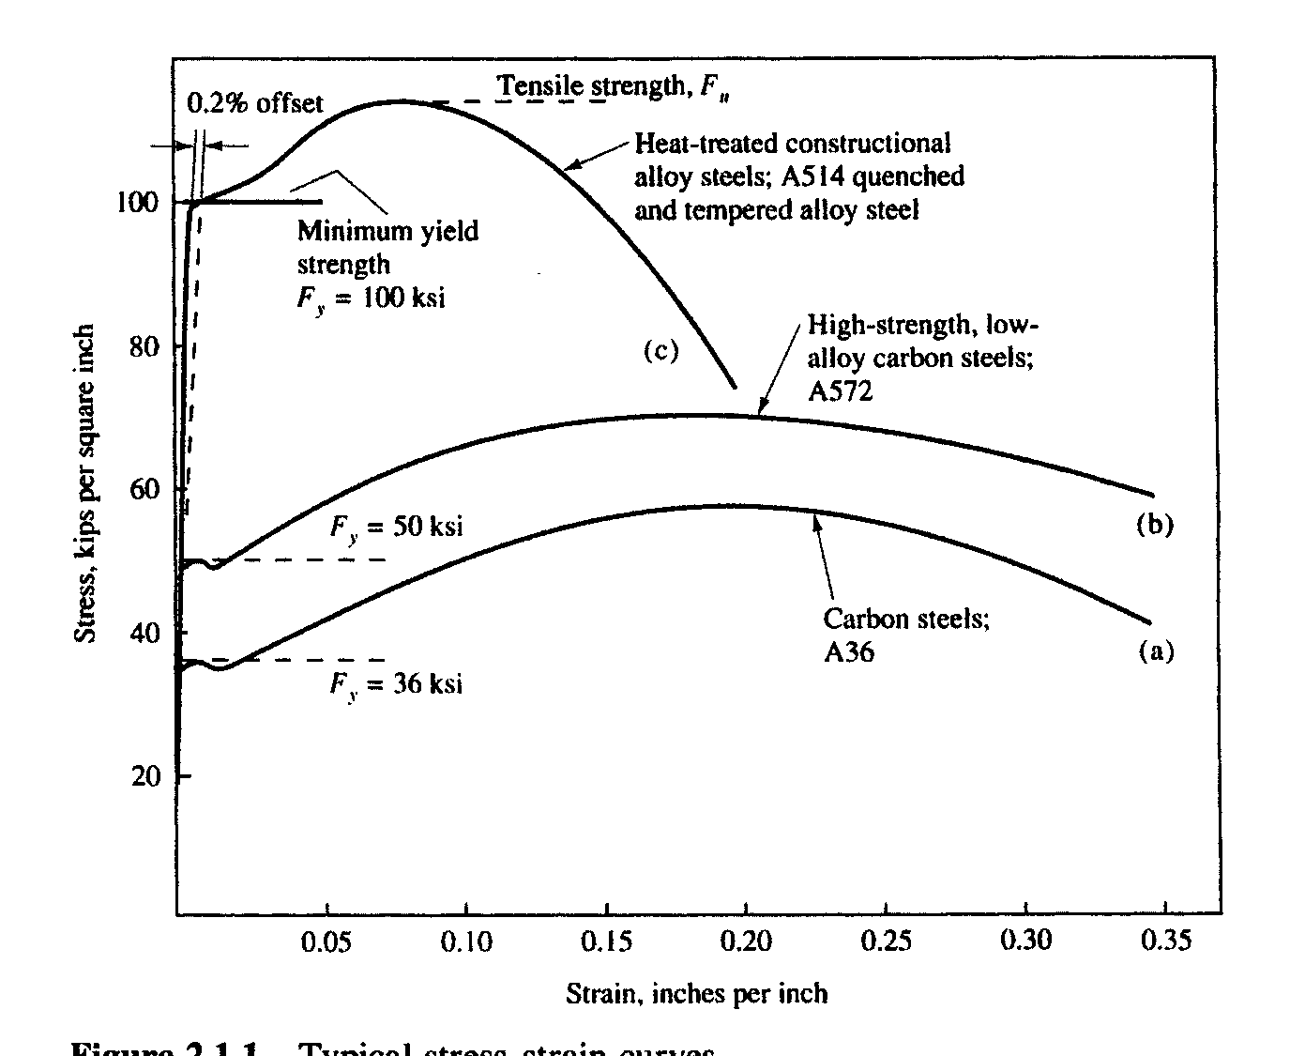
C) Alloy Steels:
These alloy steels which are quenched and tampered
to obtain Fy > 80 ksi. They do not have a well defined
yield point, and are specified a yield point by the “offset
method”, examples are A-709, A-852and A-913.
Typical stress-strain
Relations
for various steels:
19

Slide 22
Fastener Steels:
A) Carbon Steel Bolts (A-307):
These are common non-structural fasteners with
minimum tensile strength (Fu) of 60 ksi.
B) High Strength Bolts (A-325):
These are structural fasteners (bolts) with low carbon,
their ultimate tensile strength could reach 105 ksi.
C) Quenched and Tempered Bolts (A-449):
These are similar to A-307 in strength but can be
produced to large diameters exceeding 1.5 inch,
20

Slide 23
D) Heat Treated Structural Steel Bolts (A-490):
These are in carbon content (upto 0.5%)
and has other alloys. They are quenched and
re-heated (tempered) to 900ºF.
The minimum yield strength (Fy) for these bolts
ranges from 115 ksi upto 130 ksi.
21

Slide 24
Thanks

